Slide 1
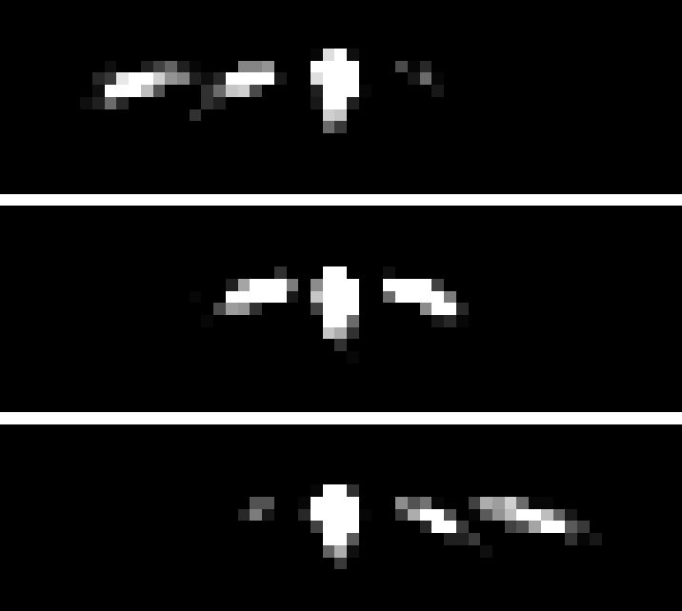

ANALYSIS OF NEUTRON DIFFRACTION BY OPTICALLY THIN GRATING
Student:
Ismaele Vincent Masiello
Supervisors:
Simon E. Wall¹
Jürgen Klepp²
¹Department of Physics and Astronomy, University of Aarhus, Ny Munkegade, Building 1520, DK-8000 Aarhus C, Denmark
²University of Vienna, Faculty of physics, Boltzmanngasse 5, 1090 Vienna, Austria

Slide 2
OVERVIEW

Slide 3
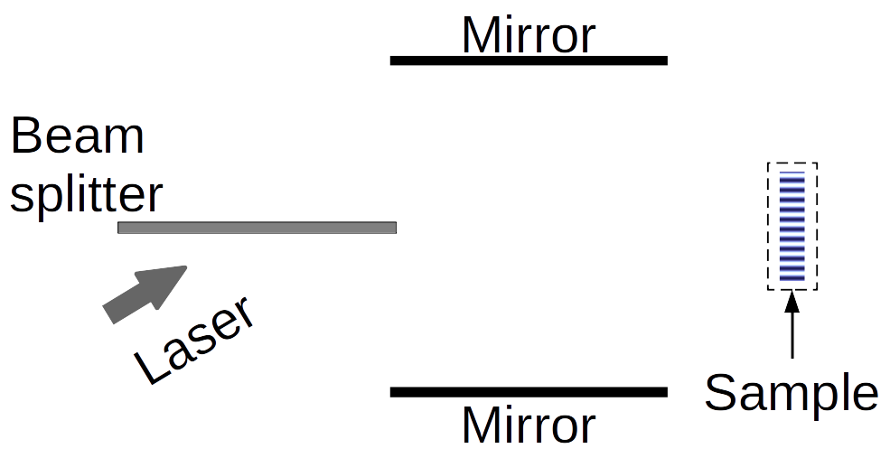
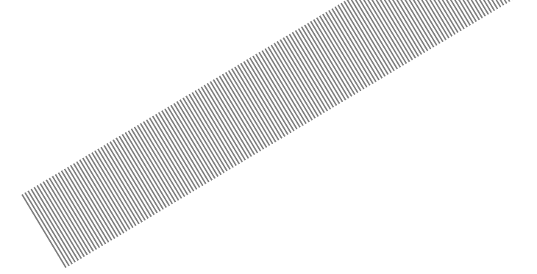
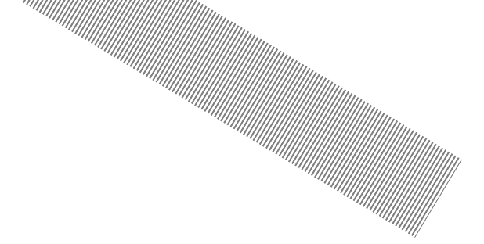
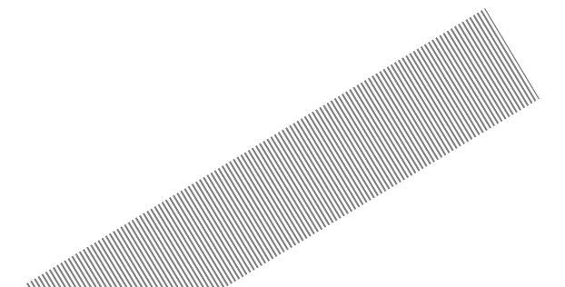
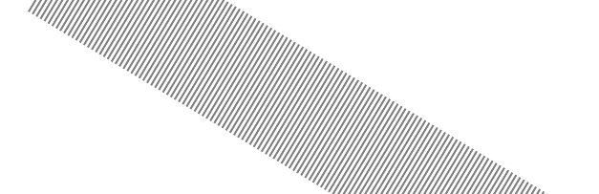
HOLOGRAPHIC GRATINGS

Slide 4
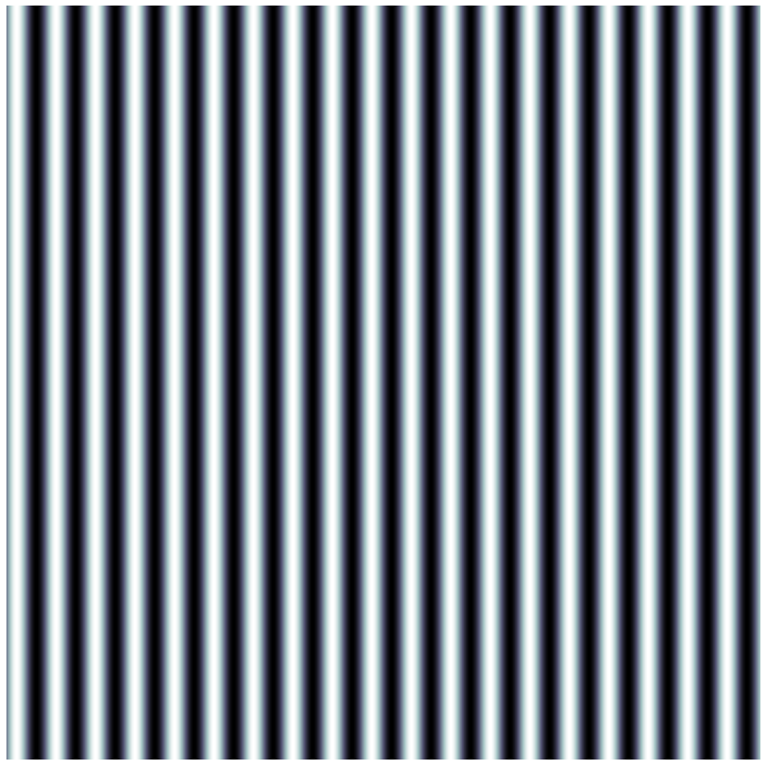
DIFFRACTION EXPERIMENT
-2
-1
Incoming
beam
0
1
θ

Slide 5
OPTICALLY THICK/THIN GRATINGS
. . .
-2
-2
-1
-1
Incoming
Incoming
beam
0
beam
0
1
. . .
T. K. Gaylord and M. G. Moharam. “Thin and thick gratings: terminology clarification”. In: Appl. Opt. 20.19 (Oct. 1981), pp. 3271–3273.

Slide 6
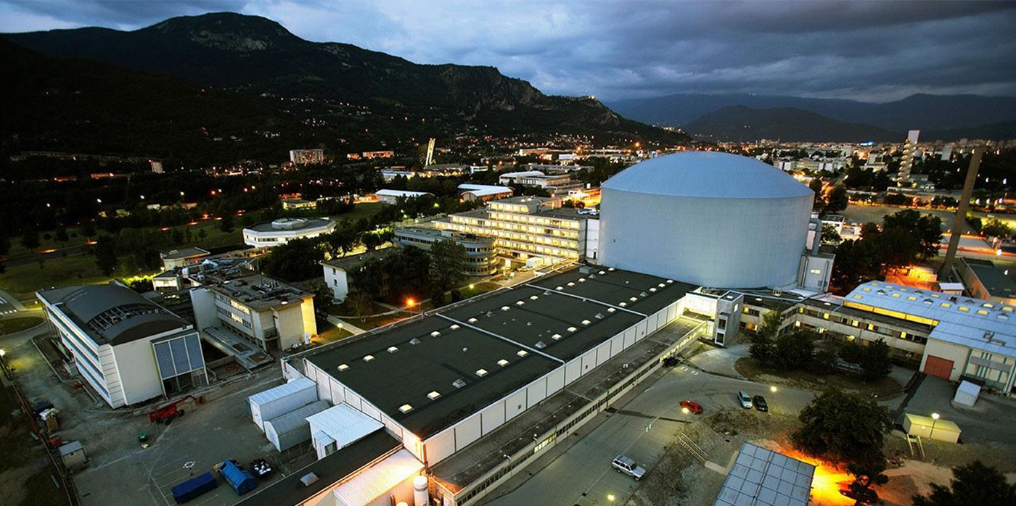
THE DATA
INSTITUTE LAUE-LANGEVIN, GRENOBLE (FR)

Slide 7
THEORY
FIRST-ORDER MULTI-WAVE MODEL

Slide 8
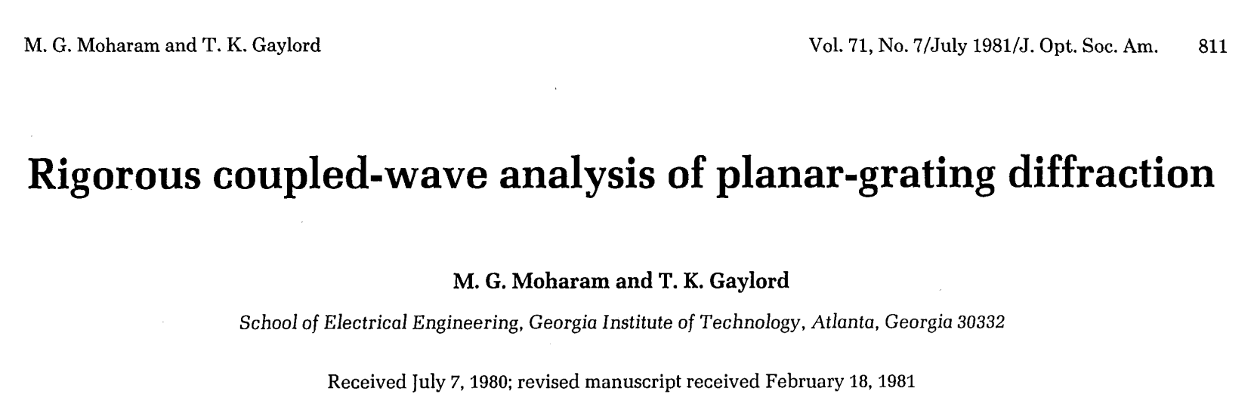
RCWA
What follows is a re-adaptation and approximation of the Rigorous Coupled-Wave Analysis (RCWA) presented by M. G. Moharam and T. K. Gaylord.
M. G. Moharam and T. K. Gaylord. “Rigorous coupled-wave analysis of planar-grating diffraction”. In: J. Opt. Soc. Am. 71.7 (July 1981), pp. 811–818.

Slide 9
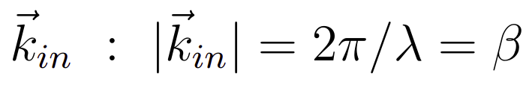
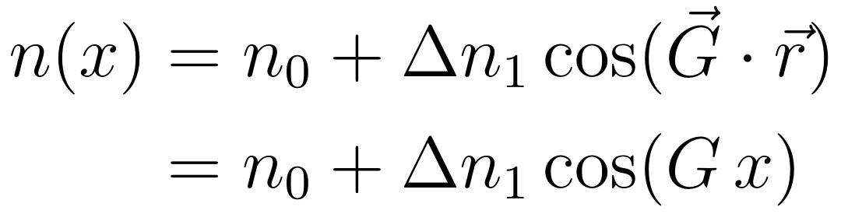
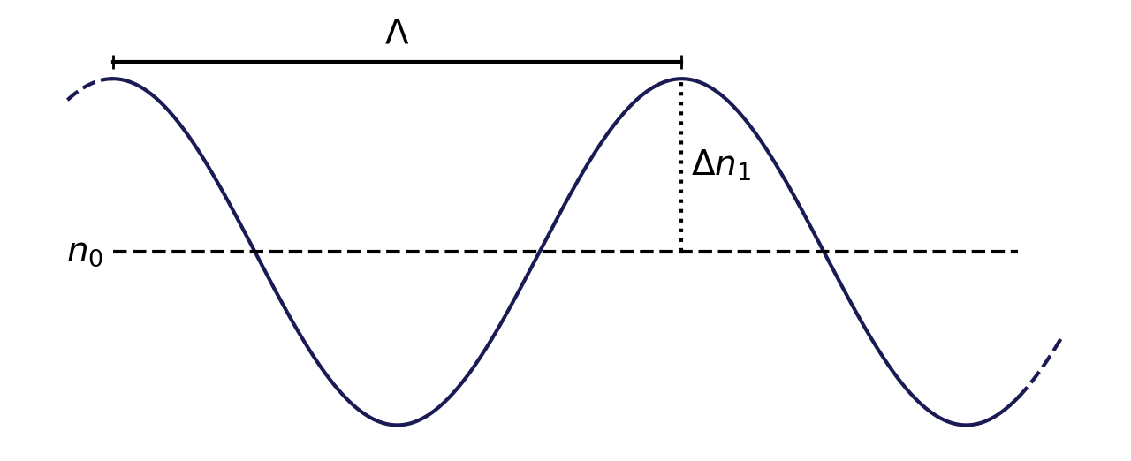
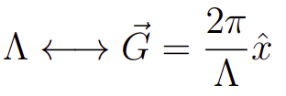
HOLOGRAPHIC GRATING
d
REFRACTIVE INDEX PROFILE
Incoming
beam
n
z
x
x

Slide 10
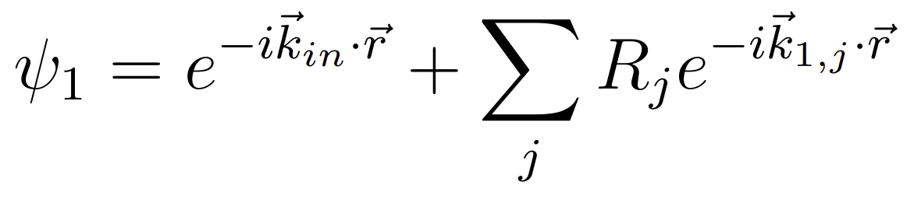
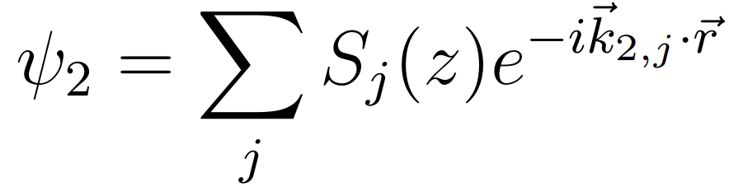
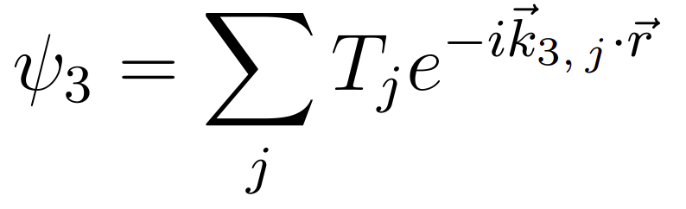
REFRACTIVE INDEX PROFILE
Region
1
Region
2
Region
3
Forward
diffracted
waves
REFRACTIVE INDEX PROFILE
REGION 1
. . .
. . .
-2
-2
-1
-1
REGION 2
0
0
z
+1
+1
. . .
. . .
Backward
diffracted
waves
REGION 3
x

Slide 11
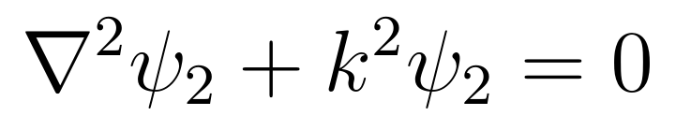
REGION 2
TIME INDEPENDENT WAVE EQUATION

Slide 12
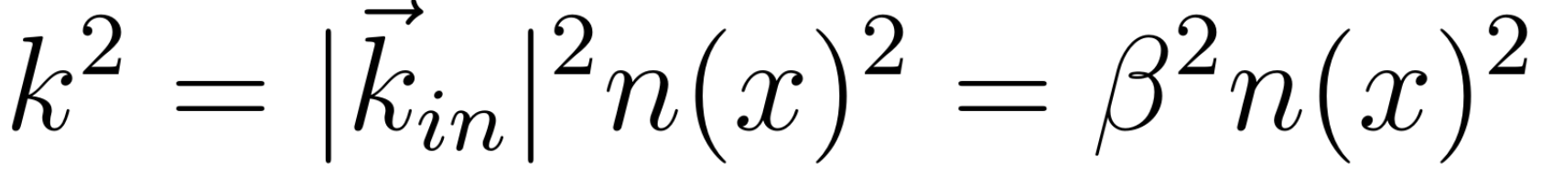
REGION 2
TIME INDEPENDENT WAVE EQUATION
REFRACTIVE INDEX PROFILE

Slide 13

REGION 2
TIME INDEPENDENT WAVE EQUATION
Martin Fally, J ̈urgen Klepp, and Yasuo Tomita. “An experimental study on the validity of diffraction theories for off-Bragg replay of volume holographic gratings”. In: Applied Physics B 108 (July 2012).

Slide 14

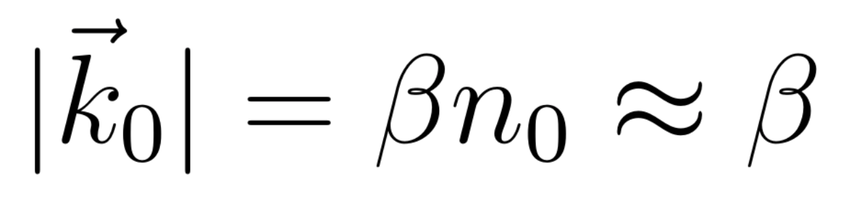
Region
1
Region
2
FLOQUET’S CONDITION
z
x
Martin Fally, J ̈urgen Klepp, and Yasuo Tomita. “An experimental study on the validity of diffraction theories for off-Bragg replay of volume holographic gratings”. In: Applied Physics B 108 (July 2012).
Matej Prijatelj et al. “Far-off-Bragg reconstruction of volume holographic gratings: A comparison of experiment and theories”. In: Physical Review A 87.6 (June 2013).

Slide 15
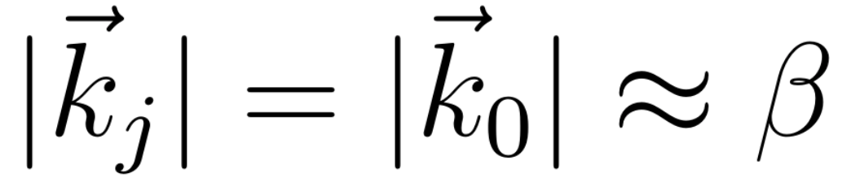
Region
1
Region
2
FLOQUET’S CONDITION
. . .
z
. . .
BETA VALUE METHOD (BVM)
x
Martin Fally, J ̈urgen Klepp, and Yasuo Tomita. “An experimental study on the validity of diffraction theories for off-Bragg replay of volume holographic gratings”. In: Applied Physics B 108 (July 2012).
Matej Prijatelj et al. “Far-off-Bragg reconstruction of volume holographic gratings: A comparison of experiment and theories”. In: Physical Review A 87.6 (June 2013).

Slide 16
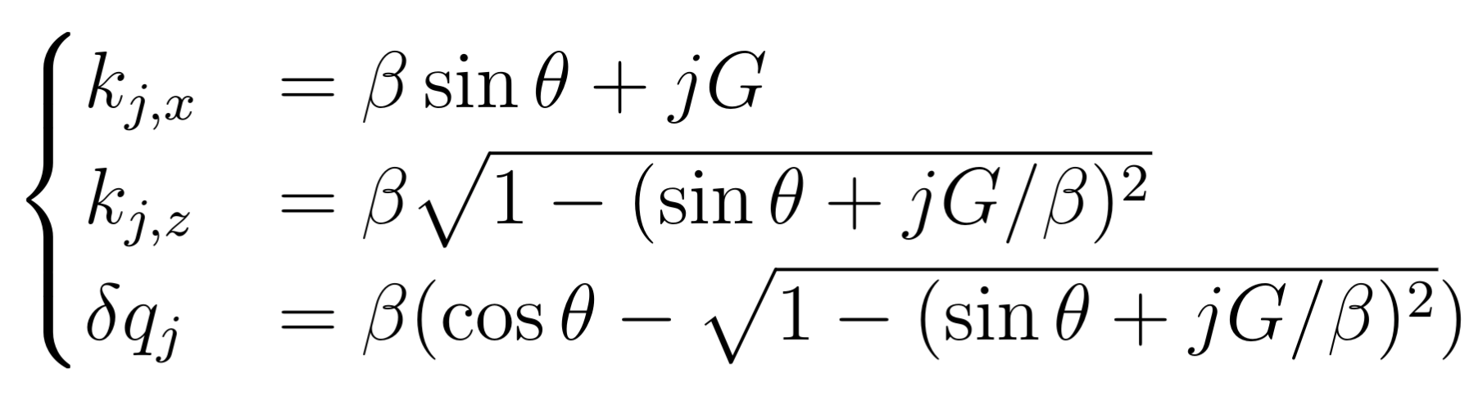
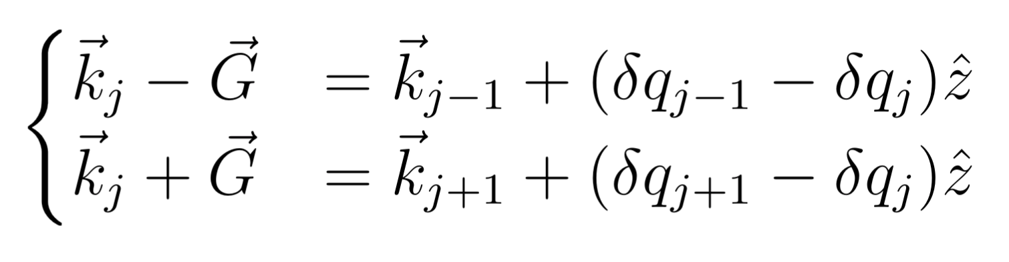
Region
1
Region
2
. . .
z
. . .
x

Slide 17
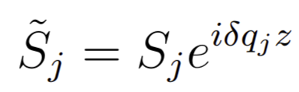
REGION 2
TIME INDEPENDENT WAVE EQUATION
FIRST ORDER APPROXIMATION OF RCWA

Slide 18
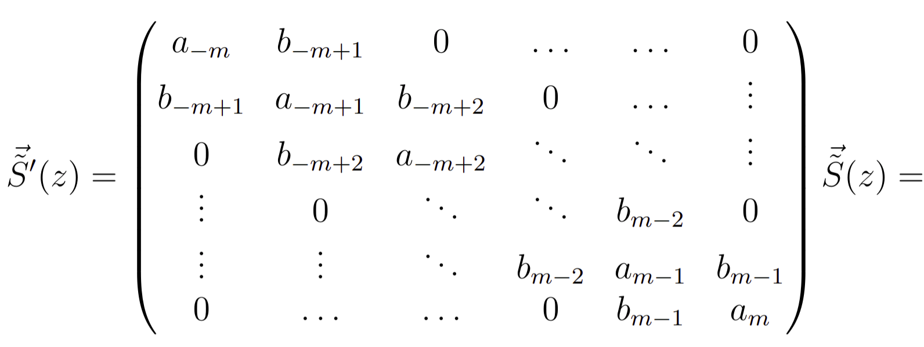
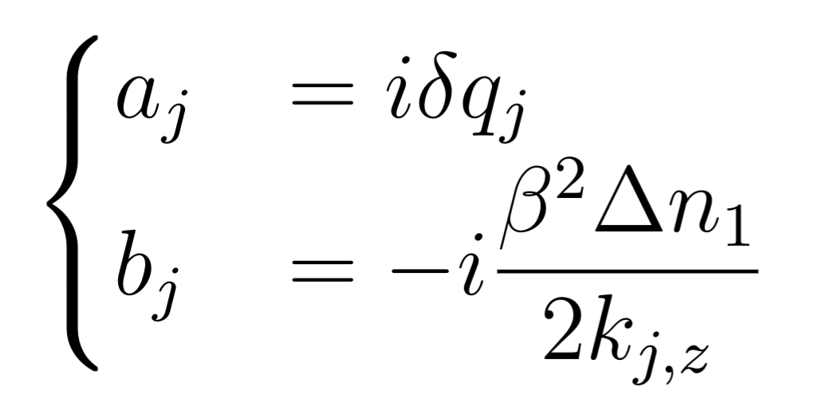
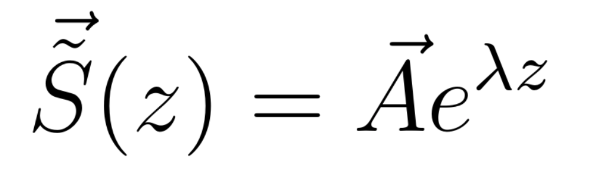
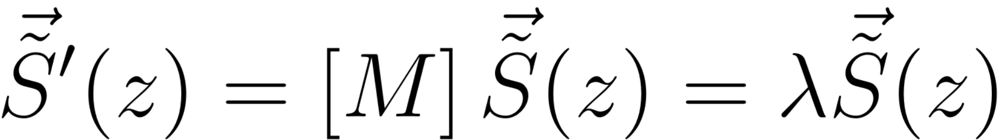
REGION 2
FIRST ORDER APPROXIMATION OF RCWA
Ansatz
Eigenvalue equation

Slide 19
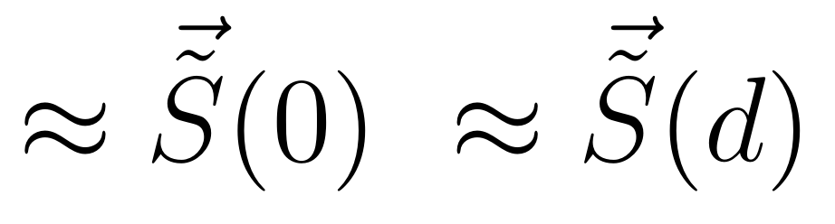
Region
1
Region
2
Region
3
Forward
diffracted
waves
. . .
. . .
-2
-2
-1
-1
0
0
z
+1
+1
. . .
. . .
Backward
diffracted
waves
x

Slide 20
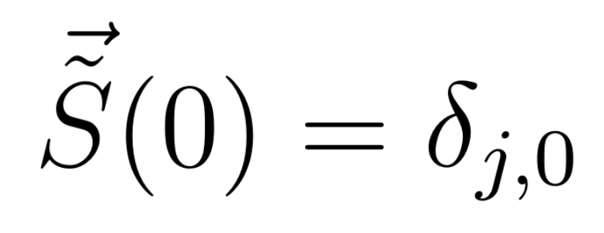
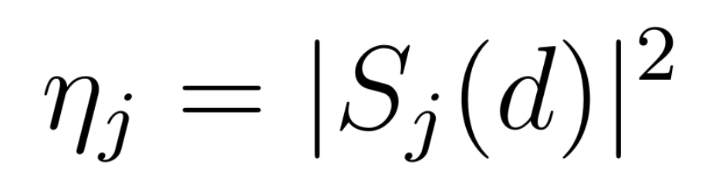
DIFFRACTION EFFICIENCIES
INITIAL CONDITIONS
J-TH ORDER DIFFRACTION EFFICIENCY

Slide 21
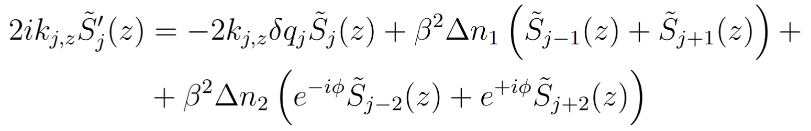
HIGHER FOURIER COMPONENTS
TWO FOURIER COMPONENTS OF THE REFRACTIVE INDEX MODULATION
FIRST ORDER WAVE EQUATION

Slide 22
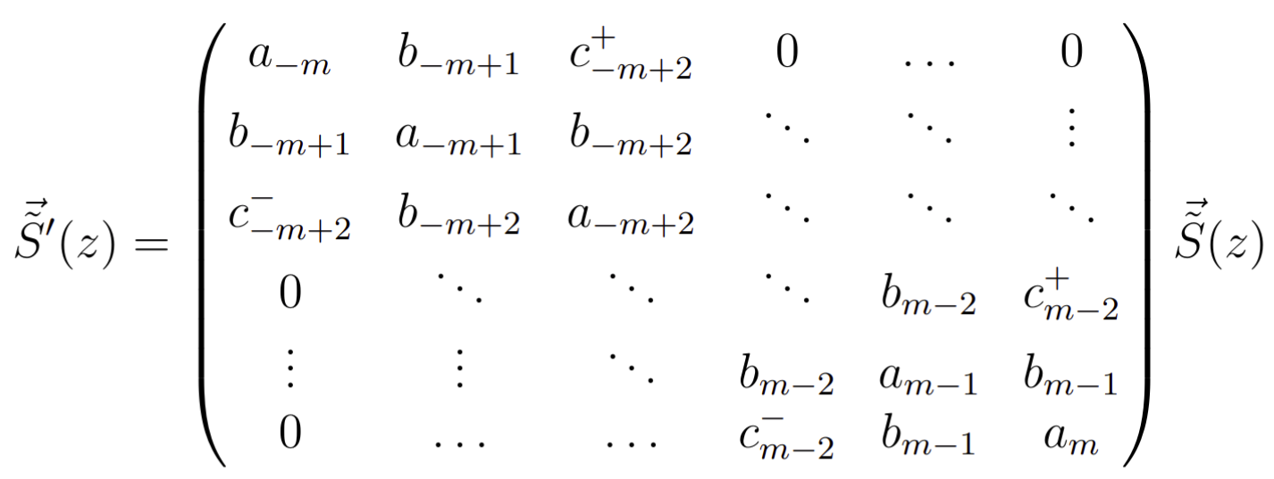
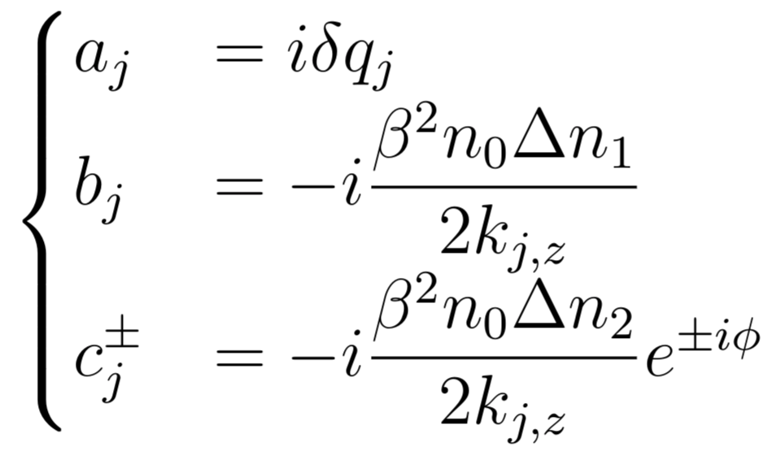
HIGHER FOURIER COMPONENTS

Slide 23
THEORY
PENDELLÖSUNG INTERFERENCE

Slide 24
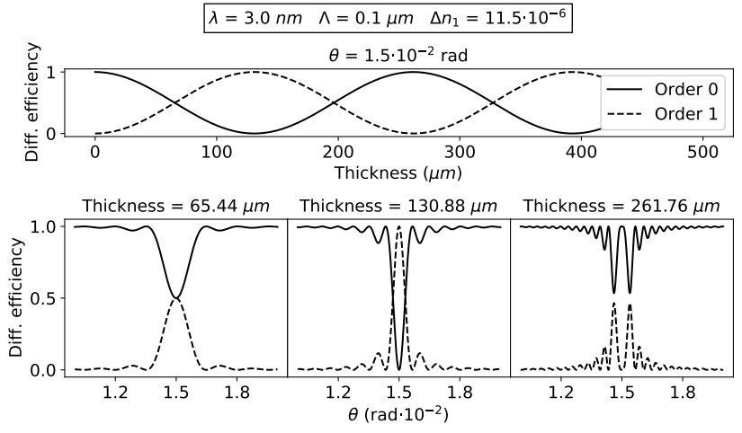
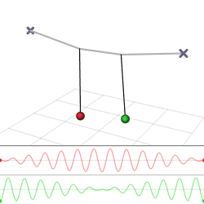
PENDELLÖSUNG INTERFERENCE
Pendellösung: (English) Pendulum solution
FIXED:
Wavelength
Incident angle
Modulation profile

Slide 25
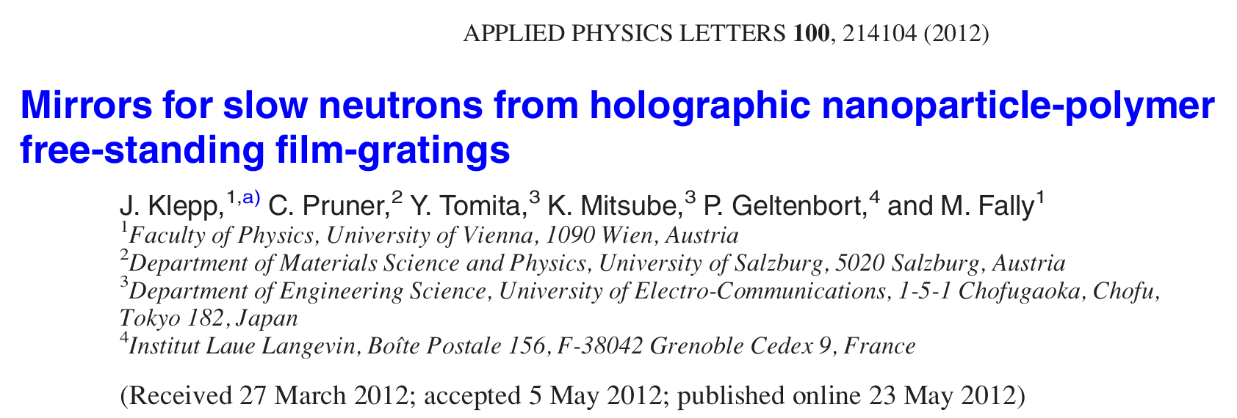
PENDELLÖSUNG INTERFERENCE

Slide 26
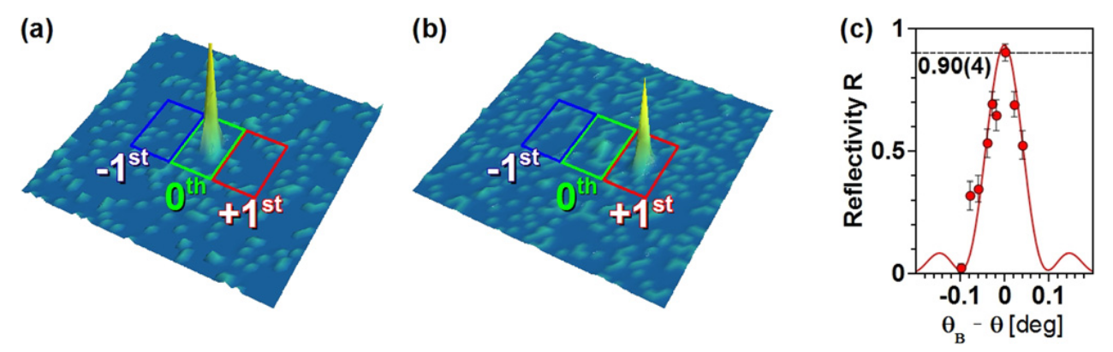
PENDELLÖSUNG INTERFERENCE

Slide 27
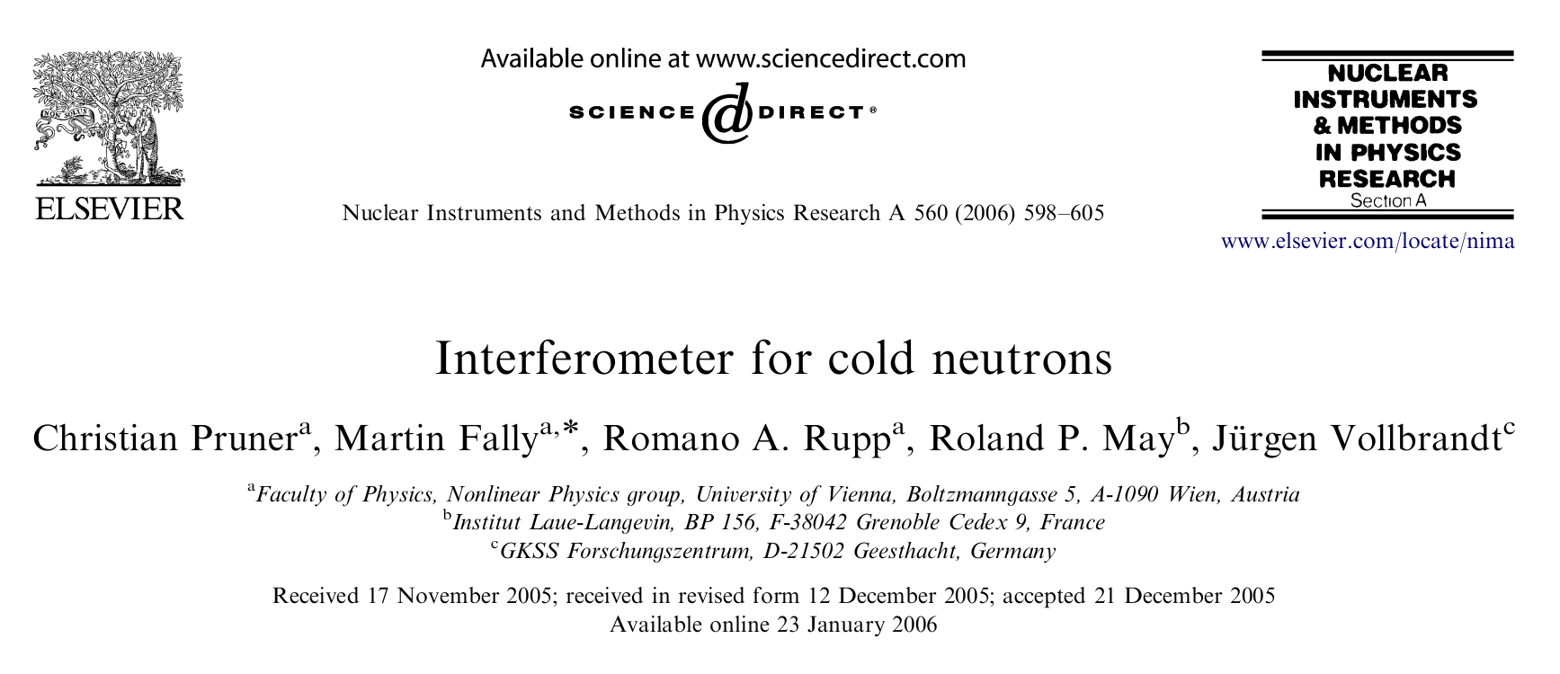
PENDELLÖSUNG INTERFERENCE
Christian Pruner et al. “Interferometer for cold neutrons”. In: Nuclear Instruments and Methods in Physics Research Section A: Accelerators, Spectrometers, Detectors and Associated Equipment 560.2 (2006), pp. 598–605. issn: 0168-9002

Slide 28
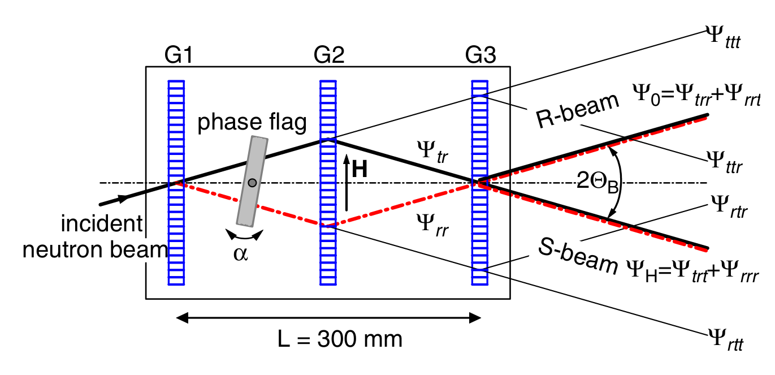
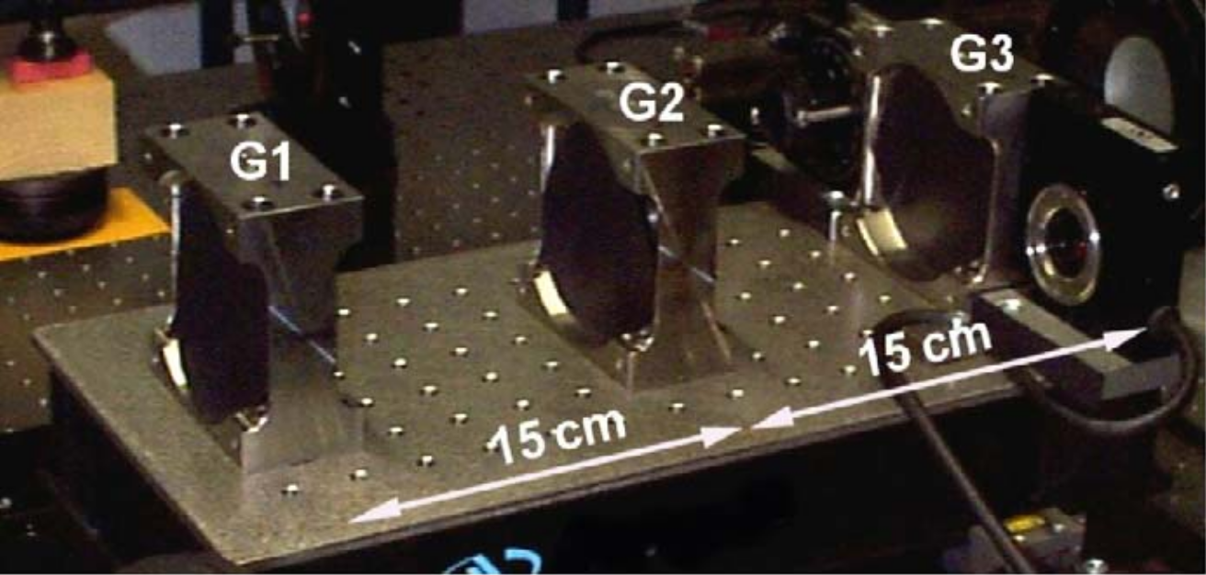
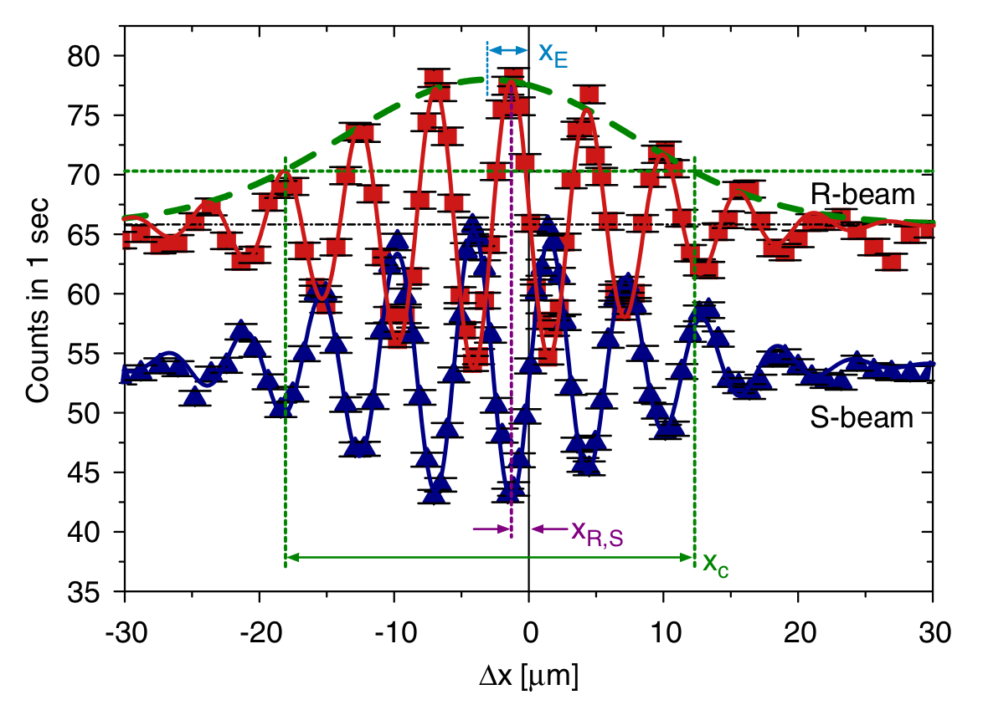
PENDELLÖSUNG INTERFERENCE

Slide 29
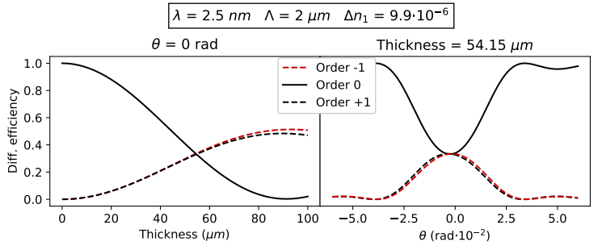
PENDELLÖSUNG INTERFERENCE

Slide 30
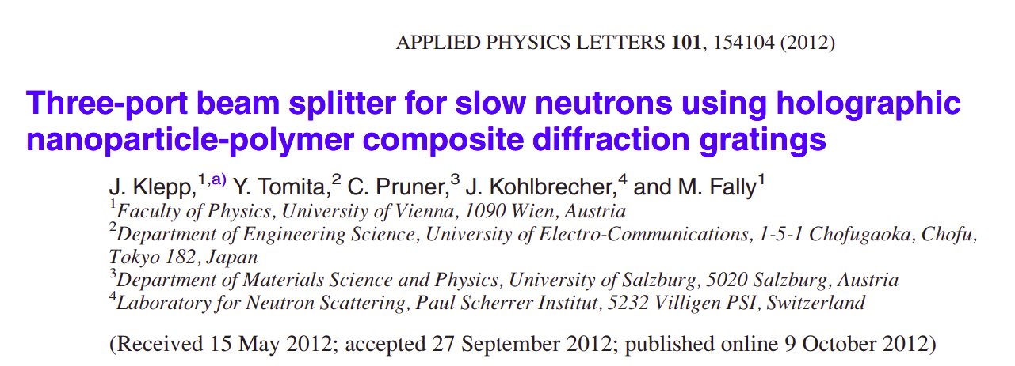
PENDELLÖSUNG INTERFERENCE
Jürgen Klepp et al. “Three-port beam splitter for slow neutrons using holographic nanoparticle-polymer composite diffraction gratings”. In: Applied Physics Letters 101.15 (2012), p. 154104.

Slide 31
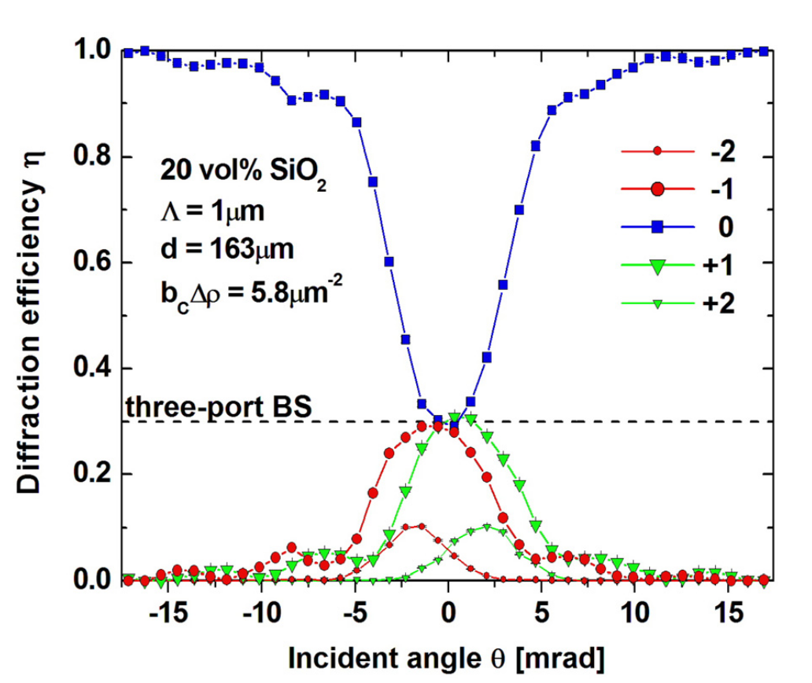
PENDELLÖSUNG INTERFERENCE
Jürgen Klepp et al. “Three-port beam splitter for slow neutrons using holographic nanoparticle-polymer composite diffraction gratings”. In: Applied Physics Letters 101.15 (2012), p. 154104.

Slide 32
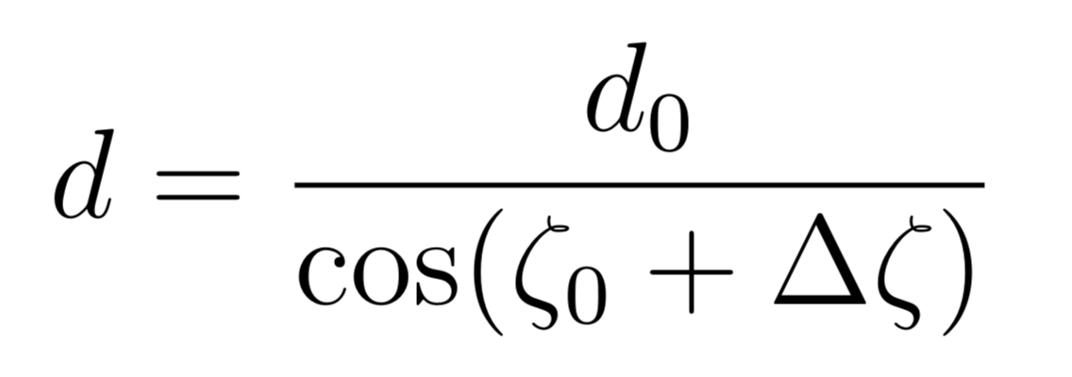
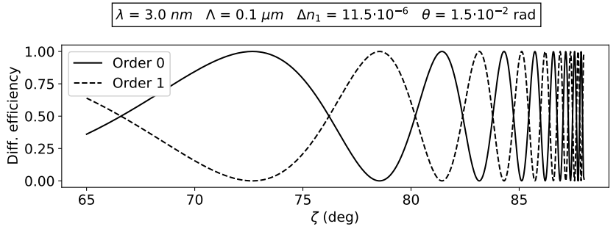
PENDELLÖSUNG INTERFERENCE
θ
THICKNESS MODULATION BY TILT
ζ
Incoming
beam
Diff. grating

Slide 33
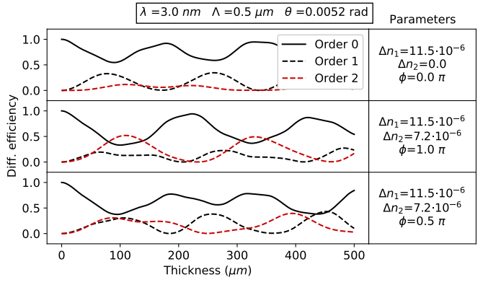
PENDELLÖSUNG INTERFERENCE

Slide 34
THE EXPERIMENT

Slide 35
THE SAMPLE
NANOPARTICLE-POLYMER COMPOSITE (NPC) DIFFRACTION GRATING
d
Thickness (d) | Grating period (Λ)
78 μm | 0.5 μm

Slide 36
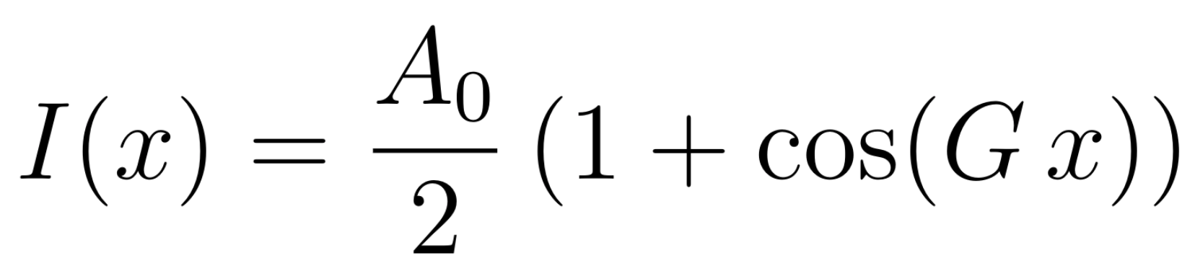
THE SAMPLE
NANOPARTICLE-POLYMER COMPOSITE (NPC) DIFFRACTION GRATING¹
LIGHT INTENSITY PROFILE
¹Yasuo Tomita, Naoaki Suzuki, and Katsumi Chikama. “Holographic manipulation of nanoparticle distribution morphology in nanoparticle-dispersed photopolymers”. In: Optics letters 30.8 (2005), pp. 839–841.

Slide 37
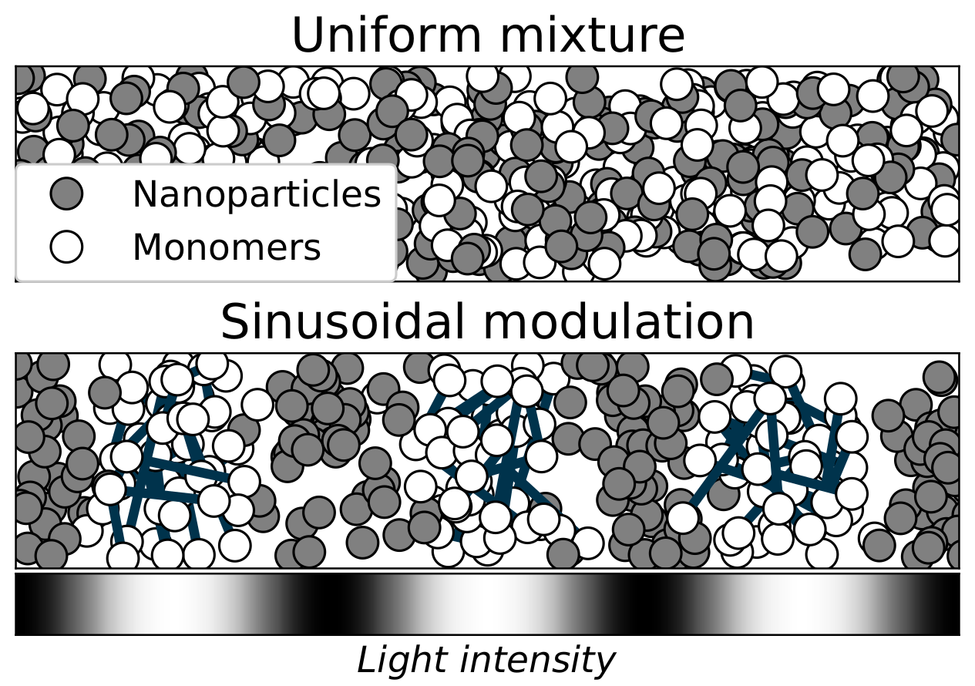
THE SAMPLE
NANOPARTICLE-POLYMER COMPOSITE (NPC) DIFFRACTION GRATING¹
¹Yasuo Tomita, Naoaki Suzuki, and Katsumi Chikama. “Holographic manipulation of nanoparticle distribution morphology in nanoparticle-dispersed photopolymers”. In: Optics letters 30.8 (2005), pp. 839–841.

Slide 38
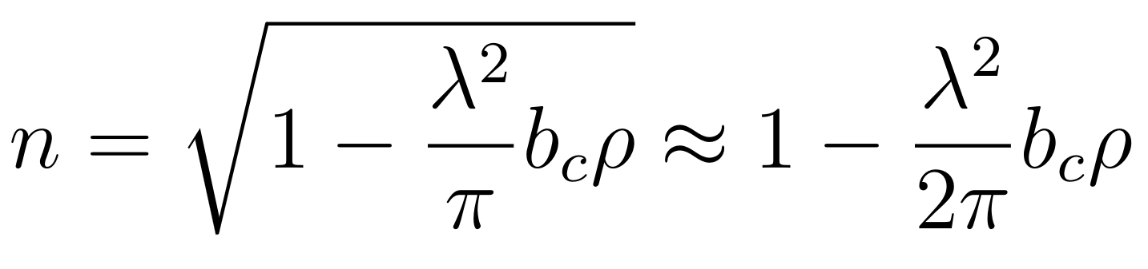
THE SAMPLE
NANOPARTICLE-POLYMER COMPOSITE (NPC) DIFFRACTION GRATING¹
NEUTRON REFRACTIVE INDEX²
²Varley F. Sears. Neutron Optics: An Introduction to the Theory of Neutron Optical Phenomena and Their Applications. Oxford series on neutron scattering in condensed matter. Oxford University Press, 1989.

Slide 39

THE SAMPLE
NANOPARTICLE-POLYMER COMPOSITE (NPC) DIFFRACTION GRATING¹
NEUTRON REFRACTIVE INDEX²
SCATTERING LENGTH-DENSITY
PARAMETER MODULATION^{3,4}
³Martin Fally, J ̈urgen Klepp, and Yasuo Tomita. “An experimental study on the validity of diffraction theories for off-Bragg replay of volume holographic gratings”. In: Applied Physics B 108 (July 2012).
⁴Jürgen Klepp et al. “Mirrors for slow neutrons from holographic nanoparticle -polymerfree-standing film-gratings”. In: Applied Physics Letters 100 (Mar. 2012), p. 214104.

Slide 40

THE SAMPLE
NANOPARTICLE-POLYMER COMPOSITE (NPC) DIFFRACTION GRATING¹
REFRACTIVE INDEX MODULATION PROFILE
¹Yasuo Tomita, Naoaki Suzuki, and Katsumi Chikama. “Holographic manipulation of nanoparticle distribution morphology in nanoparticle-dispersed photopolymers”. In: Optics letters 30.8 (2005), pp. 839–841.

Slide 41
THE MEASUREMENTS
θ
Incoming
beam
θ
-2
1
-1
0

Slide 42
THE MEASUREMENTS
θ
θ
ζ
ζ
Incoming
beam
Diff. grating
Diff. grating

Slide 43

THE MEASUREMENTS
-2
-1
0
+1
+2

Slide 44

THE MEASUREMENTS

Slide 45

THE MEASUREMENTS

Slide 46
EXPERIMENTAL SET-UP
190 cm
15 cm
146 cm
18 cm
Helium pipe
Helium pipe
Mirror
175 cm
130 cm
Neutron
beam
Sample
Cadmium frame with
~1x1 cm²
aperture
1x1 mm²
apertures

Slide 47





THE INSTRUMENT
INSTUTE LAUE-LANGEVIN - PF2
VERY COLD NEUTRONS
EXPONENTIALLY MODIFIED GAUSSIAN
Matthias Blaickner et al. “Monte-Carlo simulation of neutron transmission through nanocomposite materials for neutron-optics applications”. In: Nuclear Instruments and Methods in Physics Research Section A: Accelerators, Spectrometers, Detectors and Associated Equipment 916 (2019), pp. 154–157. issn: 0168-9002.

Slide 48


THE INSTRUMENT
Kurt Eder et al. “The new very-cold-neutron optics facility at ILL”. In: Nuclear Instruments and Methods in Physics Research Section A: Accelerators, Spectrometers, Detectors and Associated Equipment 284.1 (1989), pp. 171–175. issn: 0168-9002.

Slide 49
DATA ANALYSIS
PRELIMINARY ANALYSIS

Slide 50

PRELIMINARY ANALYSIS
Johannes Schindelin et al. “Fiji: an open-source platform for biological image analysis”. In: Nature methods 9.7 (2012), pp. 676–682

Slide 51




DIVERGENCE
DIVERGENCE HALF-ANGLE
Expected:
Measured:

Slide 52

SPOTS SHAPE
ζ=0º
ζ=69º
ζ=80º

Slide 53


SPOTS SHAPE

Slide 54

SPOTS POSITION

Slide 55

NEUTRON INTENSITY

Slide 56

HELIUM PIPES SHADOW

Slide 57
DATA ANALYSIS
DIFFRACTION EFFICIENCIES

Slide 58

REGION OF INTEREST

Slide 59



ROWS OF INTEREST
z
STEP 1: Import the measurements as 2D arrays and stack them in a 3D array
x
y
x
x
x
y
y
y
z

Slide 60

ROWS OF INTEREST
STEP 1: Import the measurements as 2D arrays and stack them in a 3D array
STEP 2: Create a projection on the (x, y) pixel plane of the maximum values along the z axis

Slide 61

ROWS OF INTEREST
STEP 1: Import the measurements as 2D arrays and stack them in a 3D array
STEP 2: Create a projection on the (x, y) pixel plane of the maximum values along the z axis
STEP 3: Find the coordinates (x,y,z) of the pixel with the absolute maximum counts
P_{max} = [x_{max}, y_{max}]

Slide 62


ROWS OF INTEREST
STEP 1: Import the measurements as 2D arrays and stack them in a 3D array
STEP 2: Create a projection on the (x, y) pixel plane of the maximum values along the z axis
STEP 3: Find the coordinates (x,y,z) of the pixel with the absolute maximum counts
STEP 4: Define an approximate range for the limiting rows of the ROI and use the signal-to-noise ratio (S/N) to find the first row
(3 consecutive pixels with S/N>3)

Slide 63

COLUMNS OF INTEREST
Same procedure row by row.
(2 consecutive pixels with S/N>1.5 and S/N>2)

Slide 64
ANGLE OF INCIDENCE
z
x
y
x
x
x
y
y
y
z

Slide 65




ANGLE OF INCIDENCE
z
x
y

Slide 66

ANGLE OF INCIDENCE

Slide 67




NEUTRON COUNTS
MEASURED DIFFRACTION EFFICIENCIES
-1
0
+1
+2
-1
0
+1
+2

Slide 68




NEUTRON COUNTS
MEASURED DIFFRACTION EFFICIENCIES
FIT PROFILE
COUNTS DISTRIBUTION

Slide 69

NEUTRON COUNTS

Slide 70

UNCERTAINTIES

Slide 71


UNCERTAINTIES
UNCERTAINTY ON NEUTRON COUNTS
UNCERTAINTY ON DIFFRACTION EFFICIENCY

Slide 72

DIFFRACTION EFFICIENCY

Slide 73

PENDELLÖSUNG EFFECT

Slide 74
DATA ANALYSIS
WAVELENGTH DISTRIBUTION AND BEAM DIVERGENCE

Slide 75


WAVELENGTH DISTRIBUTION
MONOCHROMATIC AND PERFECTLY PARALLEL
WAVELENGTH DISTRIBUTION CONTRIBUTION

Slide 76


WAVELENGTH DISTRIBUTION
INVERSE TRANSFORM SAMPLING
WEIGHTED SAMPLING

Slide 77

WAVELENGTH DISTRIBUTION
EXPONENTIALLY MODIFIED GAUSSIAN
INITIAL PARAMETERS

Slide 78



BEAM DIVERGENCE
BEAM DIVERGENCE CONTRIBUTION
BEAM PROFILE

Slide 79
DATA ANALYSIS
FITS RESULTS

Slide 80

FIT RESULTS
MODEL
9 coupled waves (0, ±1, ±2, ±3, ±4)
n₀ = 1
EMG wavelength distribution
Gaussian beam profile

Slide 81


PERFECTLY SINUSOIDAL GRATING
GRATING PROFILE
EMG PARAMETERS
FREE PARAMETERS

Slide 82

PERFECTLY SINUSOIDAL GRATING

Slide 83

PERFECTLY SINUSOIDAL GRATING

Slide 84

PERFECTLY SINUSOIDAL GRATING
GRATING PROFILE
EMG PARAMETERS
FREE PARAMETERS

Slide 85

PERFECTLY SINUSOIDAL GRATING

Slide 86

PERFECTLY SINUSOIDAL GRATING
GRATING PROFILE
FREE PARAMETERS

Slide 87

PERFECTLY SINUSOIDAL GRATING

Slide 88

PERFECTLY SINUSOIDAL GRATING

Slide 89

PERFECTLY SINUSOIDAL GRATING
WAVELENGTH DISTRIBUTION

Slide 90

PERFECTLY SINUSOIDAL GRATING
WAVELENGTH DISTRIBUTION

Slide 91

PERFECTLY SINUSOIDAL GRATING
WAVELENGTH DISTRIBUTION

Slide 92
PERFECTLY SINUSOIDAL GRATING
WAVELENGTH DISTRIBUTION

Slide 93

PERFECTLY SINUSOIDAL GRATING
SCATTERING LENGTH-DENSITY PARAMETER

Slide 94

PERFECTLY SINUSOIDAL GRATING
PENDELLÖSUNG INTERFERENCE

Slide 95

PERFECTLY SINUSOIDAL GRATING

Slide 96

PERFECTLY SINUSOIDAL GRATING

Slide 97
TWO FOURIER COMPONENTS
GRATING PROFILE
FREE PARAMETERS

Slide 98


TWO FOURIER COMPONENTS

Slide 99
TWO FOURIER COMPONENTS

Slide 100


TWO FOURIER COMPONENTS

Slide 101
TWO FOURIER COMPONENTS

Slide 102

PERFECTLY SINUSOIDAL GRATING
PENDELLÖSUNG INTERFERENCE

Slide 103

THREE FOURIER COMPONENTS?

Slide 104
SUMMARY AND CONCLUTIONS
FITS RESULTS

Slide 105

SUMMARY
EXPERIMENTAL ASPECTS
CAUSES
Temporary changes in the neutron source
Temporary changes in the neutron flux
intentional interruption by people operating in the same facility;

Slide 106
SUMMARY
EXPERIMENTAL ASPECTS
SOLUTION
Plotting the total neutron counts at the end of each measurement (or measurement session) can disclose any relevant variation in the neutron flux, which might be an indication of a compromised measurement that needs to
be discarded or re-taken.

Slide 107
SUMMARY
EXPERIMENTAL ASPECTS
CAUSES
Changes in the experimental setting
Mistakes during set-up adjustments

Slide 108
SUMMARY
EXPERIMENTAL ASPECTS
SOLUTION
Converting the
measurements to images and running a quick scan of the position of the spots
reveal unwanted changes in the experimental set-up.

Slide 109
SUMMARY
EXPERIMENTAL ASPECTS
CAUSES
Broad wavelength distribution
Ratio Λ/λ

Slide 110
SUMMARY
EXPERIMENTAL ASPECTS
SOLUTION
Using a neutron source with a thinner WL distribution, or adjusting the ratio Λ/λ

Slide 111
SUMMARY
EXPERIMENTAL ASPECTS
CAUSES
He pipes used to reduce neutron-air scattering

Slide 112
SUMMARY
EXPERIMENTAL ASPECTS
SOLUTIONS
Increasing pipes dimension

Slide 113

SUMMARY
FIT RESULTS

Slide 114

SUMMARY
FIT RESULTS

Slide 115

SUMMARY
FIT RESULTS

Slide 116
CONCLUSIONS
In general, the issues related to the experimental side can be prevented by implementing a less thorough version of the steps presented in the preliminary analysis at the end of each measurement session.
Using He pipes with a larger diameter can avert any unwanted cut-off or increase in noise in the ROI.
Despite the analysis not being able to define common values for the scattering length-density modulation parameters and the phase, it revealed interesting features of the diffraction efficiencies and of the experiment that are worth of deeper investigation. Repeating the measurements addressing the issues brought up in this thesis might further improve the quality of the results.

